Slide 1
Structural design and hierarchy
Structural design in Verilog
Hierarchy - Including lower-level sub-systems within a higher-level module to produce the desired functionality
Good design practice because it enables design partitioning
contain the instantiation and interconnections of other sub-systems
Each lower-level module that is called is executed concurrently by the calling module.

Slide 2
Lower-level module instantiation
In Verilog, the syntax for instantiating a lower-level module is as follows.
module_name <instance_identifier> ( port mapping… );
Module name that is being called ➔ must match the lower-level module name exactly, including case
Optional instance identifier ➔ Useful when instantiating multiple instances of the same lower-level module
Port mapping ➔ Two techniques to connect signals to the ports of the lower-level module, explicit and positional.

Slide 3
Explicit Port Mapping
Names of the ports of the lower-level sub-system are provided along with the signals they are connected to.
The lower-level port name is preceded by a period (.) while the signal it is being connected to is enclosed within parentheses.
The port connections can be listed in any order since the details of the connection (i.e., port name to signal name) are explicit. Each connection is separated by a comma.
The syntax for explicit port mapping is as follows:
module_name <instance identifier> (.port_name1 ( signal1), . port_name2 ( signal2 ), etc.);

Slide 4
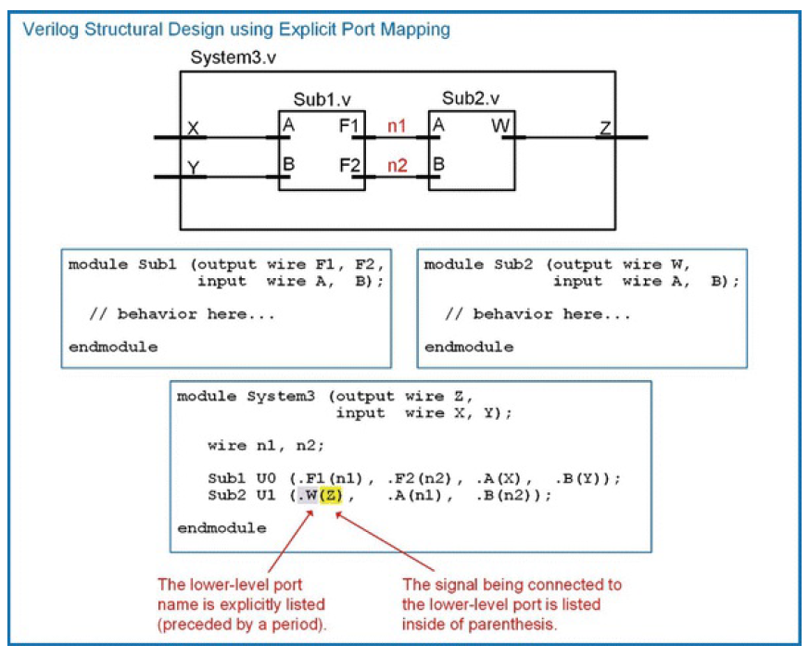

Slide 5
Positional Port Mapping
Names of the ports of the lower-level modules are not explicitly listed.
Instead, the signals to be connected to the lower-level system are listed in the same order in which the ports were defined in the sub-system. Each signal name is separated by a comma.
This approach requires less text to describe the connection, but can also lead to misconnections due to inadvertent mistakes in the signal order.
The syntax for positional port mapping is as follows:
module_name : <instance_identifier> ( signal1, signal2 , etc.);

Slide 6
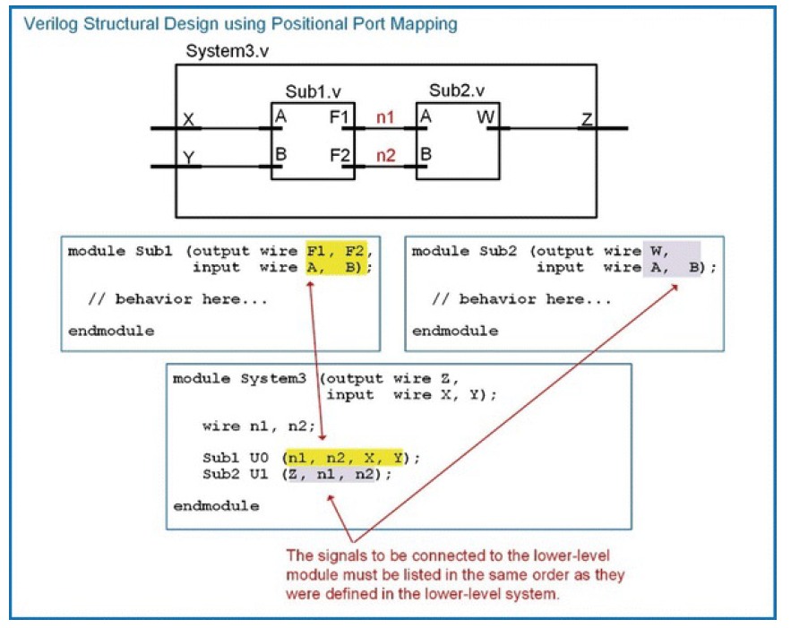

Slide 7
Gate level primitives
Verilog provides the ability to model basic logic functionality through the use of primitives.
A primitive is a logic operation that is simple enough that it doesn’t require explicit modeling.
Verilog provides a set of gate level primitives to model simple logic operations.
not(), and(), nand(), or(), nor(), xor(), and xnor().
Each of these primitives are instantiated as lower-level subsystems with positional port mapping.
The port order for each primitive has the output listed first followed by the input(s).
The output and each of the inputs are scalars.
Gate level primitives do not need to explicitly created as they are provided as part of the Verilog standard.

Slide 8
Gate level primitives
One of the benefits of using gate-level primitives is that the number of inputs is easily scaled as each primitive can accommodate an increasing number of inputs automatically.
Modeling using this approach essentially provides a gate-level netlist, so it represents a very low-level, detailed gate level implementation that is ready for technology mapping.

Slide 9
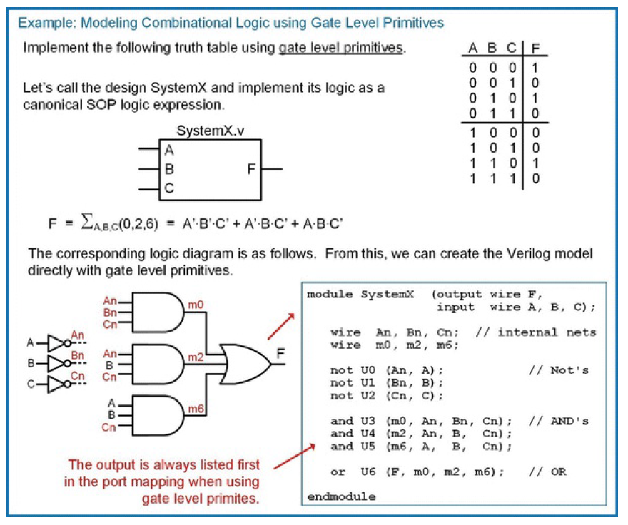

Slide 10
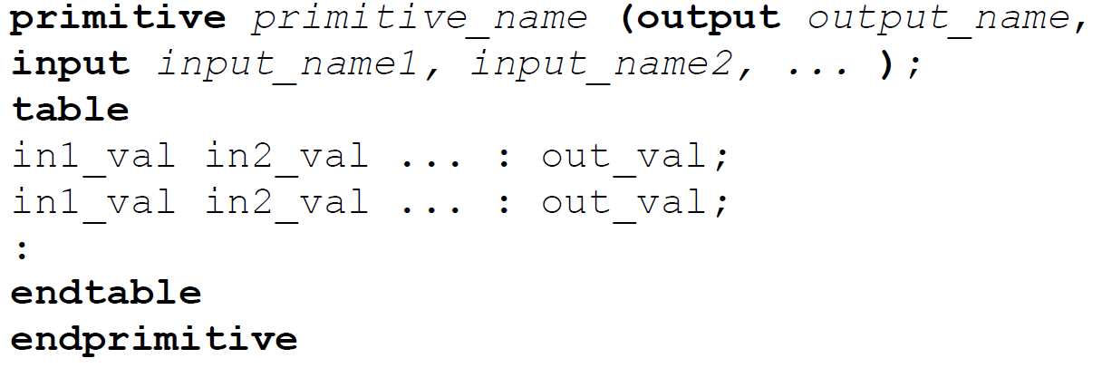
User defined primitives(UDP)
A system that describes the behavior of a low-level component using a logic table.
Useful for large truth tables where it is more convenient to list the functionality in table form.
UDPs are lower-level sub-systems that are intended to be instantiated in higher-level modules just like gate-level primitives, with the exception that the UPD needs to be created in its own file.
The syntax for a UDP is as follows:

Slide 11
User defined primitives(UDP)
A UDP must list its output(s) first in the port definition.
It also does not require types to be defined for the ports.
For combinational logic UDPs, all ports are assumed to be of type wire.

Slide 12
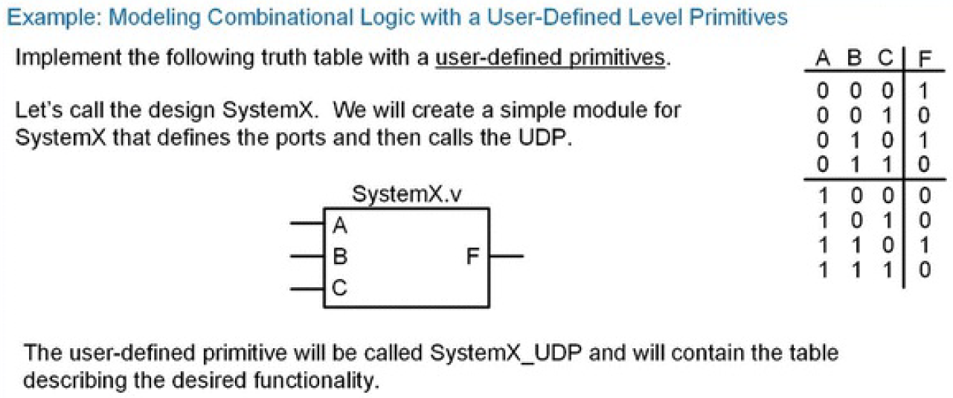

Slide 13
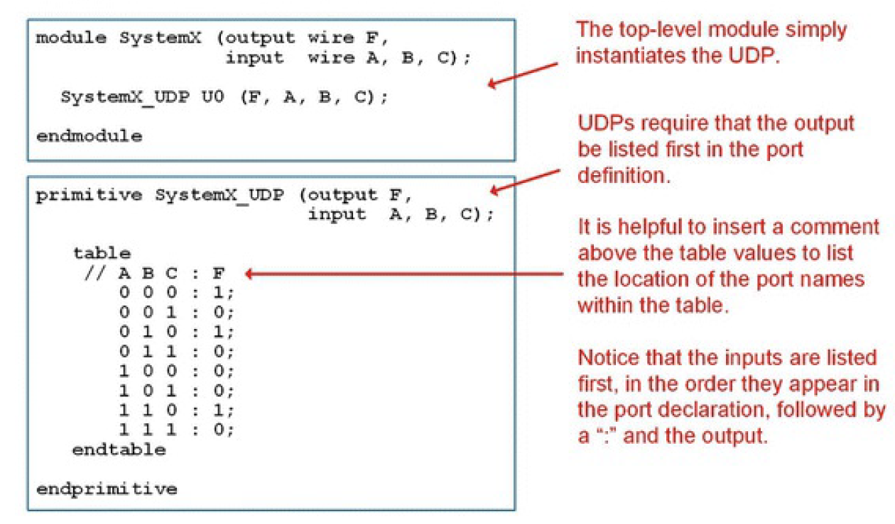

Slide 14
Adding delay to primitives
The delay is inserted after the primitive name but before the instance name.
Example:
not #2 U0 (An, A); // Gate level primitive for an inverter with delay of 2
and #3 U3 (m0, An, Bn, Cn); // Gate level primitive for an AND gate with delay of 3
SystemX_UDP #1 U0 (F, A, B, C); // UDP with a delay of 1.

Slide 15
Types of Modeling in Verilog
Behavioral Modeling
Describes the circuit’s functionality using procedural blocks (always, if, case) without focusing on hardware structure.
Dataflow Modeling
Describes the movement of data in the system and determines the logic functions between different signals. Describes the circuit using Boolean expressions and continuous assignments (assign).
Gate-Level Modeling
Represents the circuit as a direct netlist of built-in logic gate primitives (and, or, xor, etc.).
Structural Modeling
Builds the circuit by hierarchically interconnecting submodules or components.

Slide 16
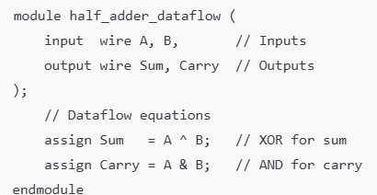
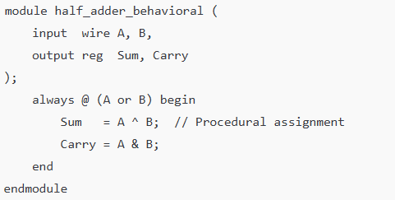
Half Adder (HA) in all four modeling styles — Dataflow, Behavioral, Gate and Structural
Dataflow Behavioral
output reg → required because values are assigned inside an always block
always @(A or B) → block executes whenever A or B changes.

Slide 17
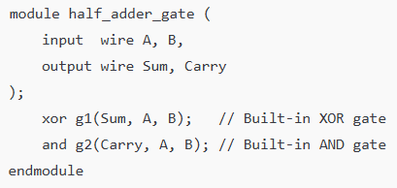
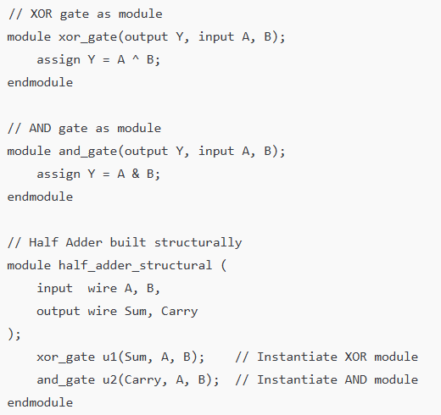
Half Adder (HA) in all four modeling styles — Dataflow, Behavioral, and
Gate
Structural
Uses built-in gate primitives:
xor g1(Sum, A, B); → XOR gate instance g1.
and g2(Carry, A, B); → AND gate instance g2

Slide 18
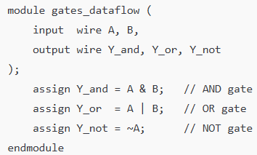
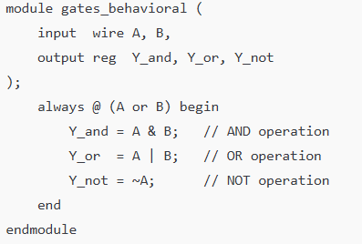
Verilog HDL - Modelling of the basic gates using Gate level, Behavioral, Structural, Dataflow
Dataflow Modeling
Behavioral Modeling

Slide 19
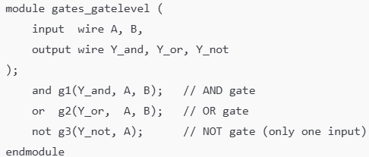
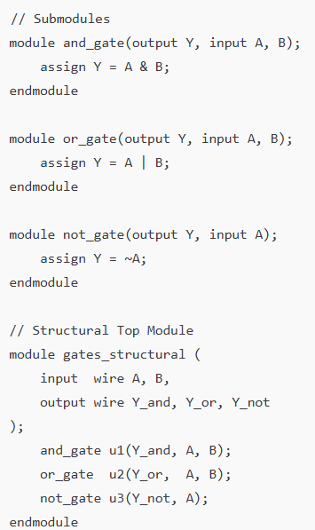
Verilog HDL - Modelling of the basic gates using Gate level, Behavioral, Structural, Dataflow
Gate-Level Modeling
Structural Modeling

